Slide 1
2023 Street & Utility Improvements Improvement Hearing
July 18th, 2022

Slide 2
2023 Street and Utility Improvements
The City of Montgomery has identified a Capital Improvement Plan to address aging infrastructure and the following locations are proposed with this project:
1st, 2nd, and 3rd Streets
Reconstruction from Boulevard Avenue to Hickory Avenue
4th Street
Mill and Overlay from Boulevard Avenue to Hickory Avenue
Linden Avenue
Reconstruction from 1st Street to 5th Street
Mill Avenue
Reconstruction from 1st Street to 4th Street
Mill and Overlay from 4th Street to 5th Street

Slide 3
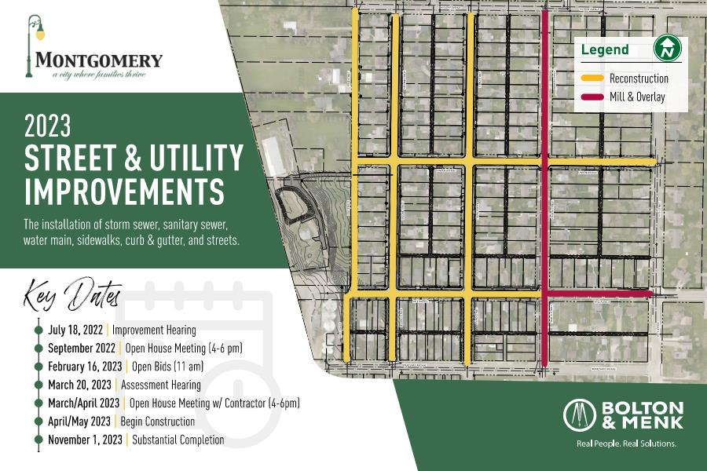
INSERT PROJECT LOCATION FIGURE WHEN FINALIZED

Slide 4
What’s Under My Street? https://www.youtube.com/watch?v=G2wZx5EgU1E#action=share

Slide 5
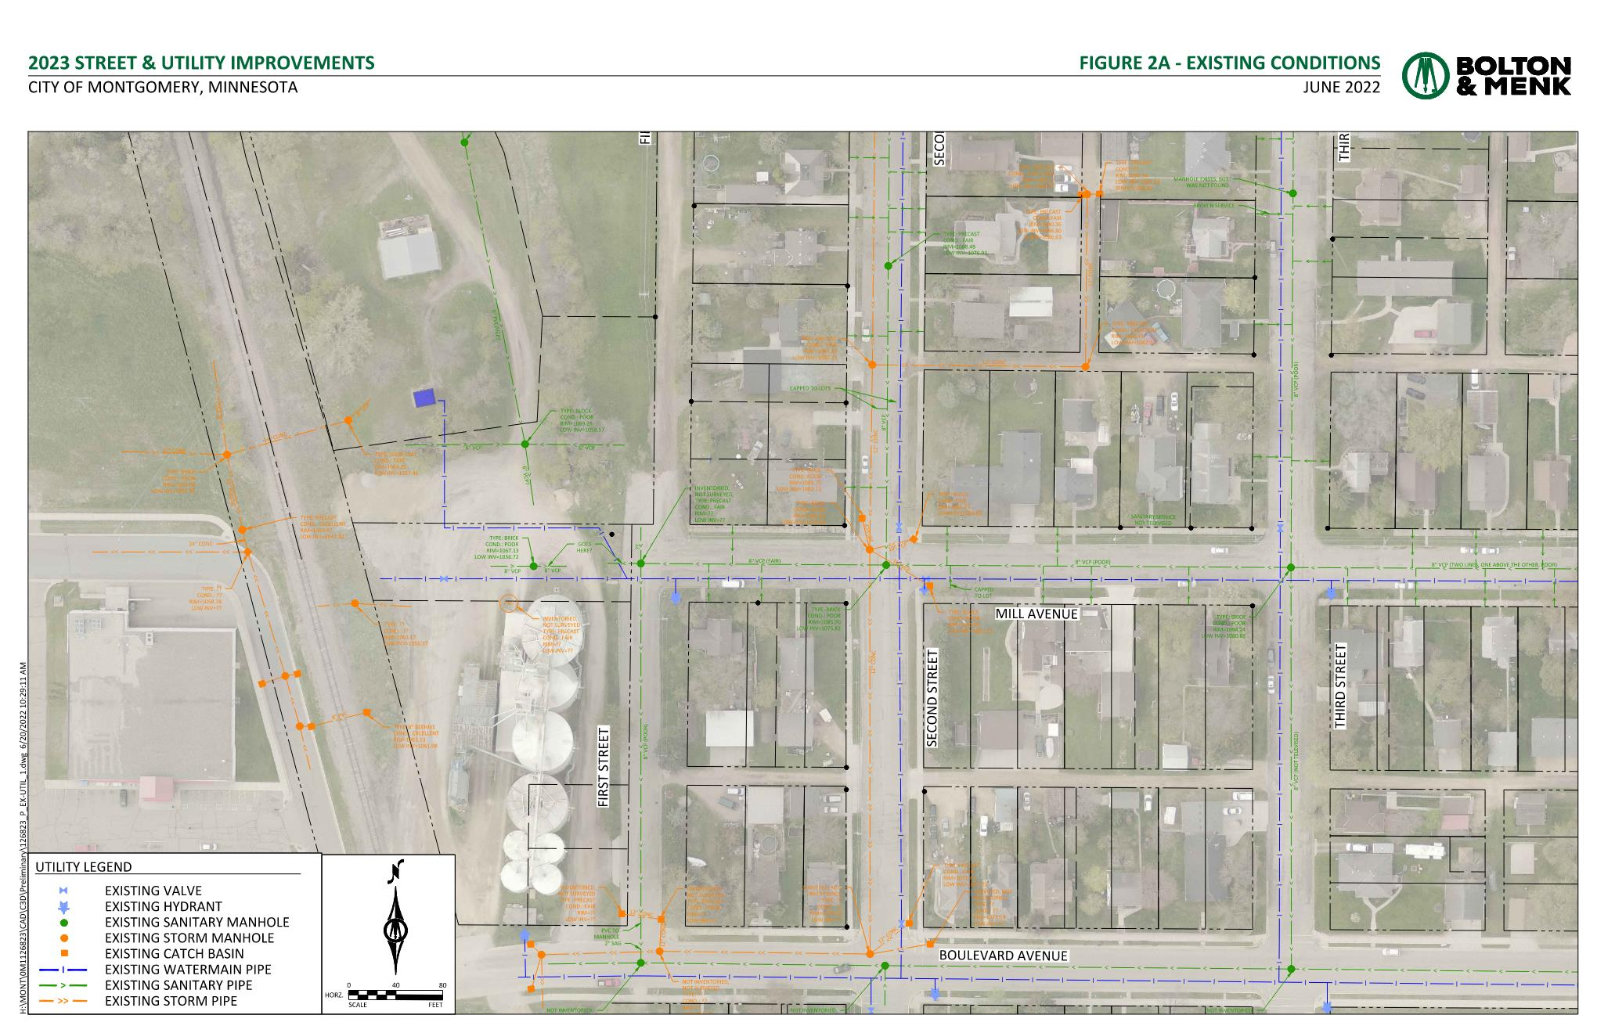
INSERT EXISTING CONDITIONS FIGURES WHEN FINALIZED, ADD SLIDES AS NECESSARY

Slide 6
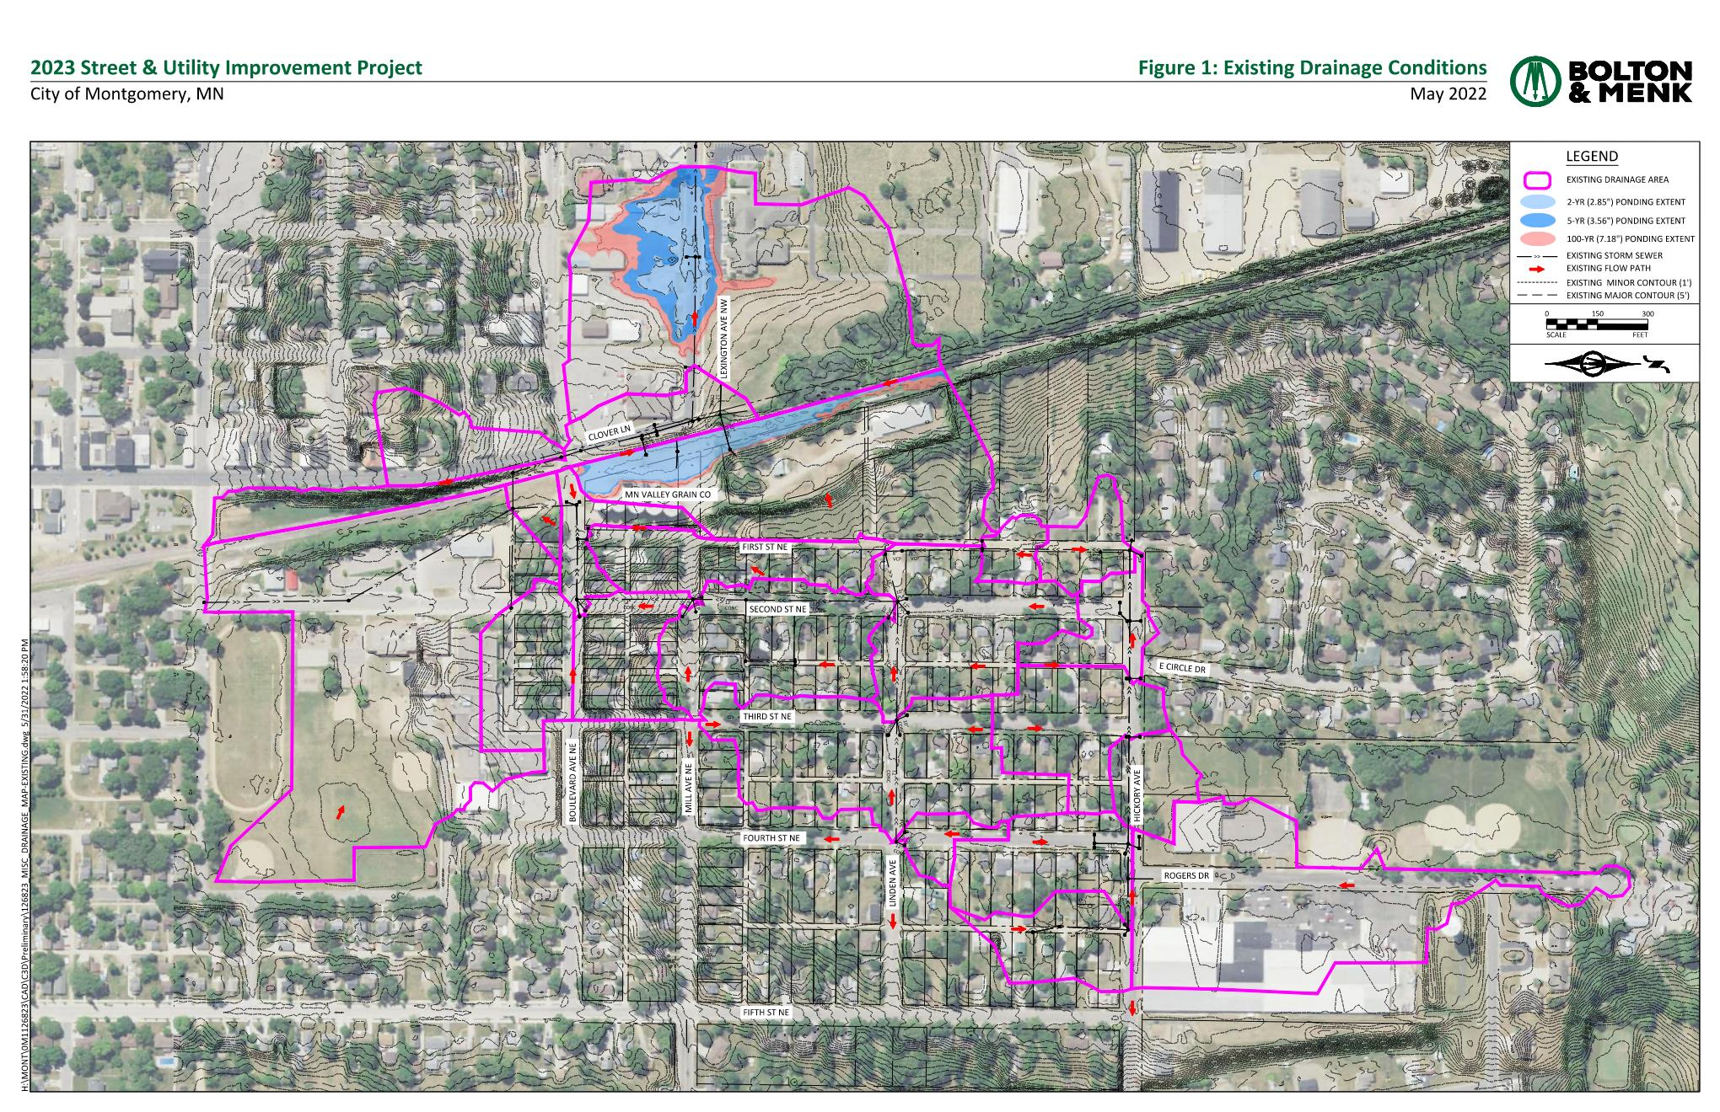

Slide 7
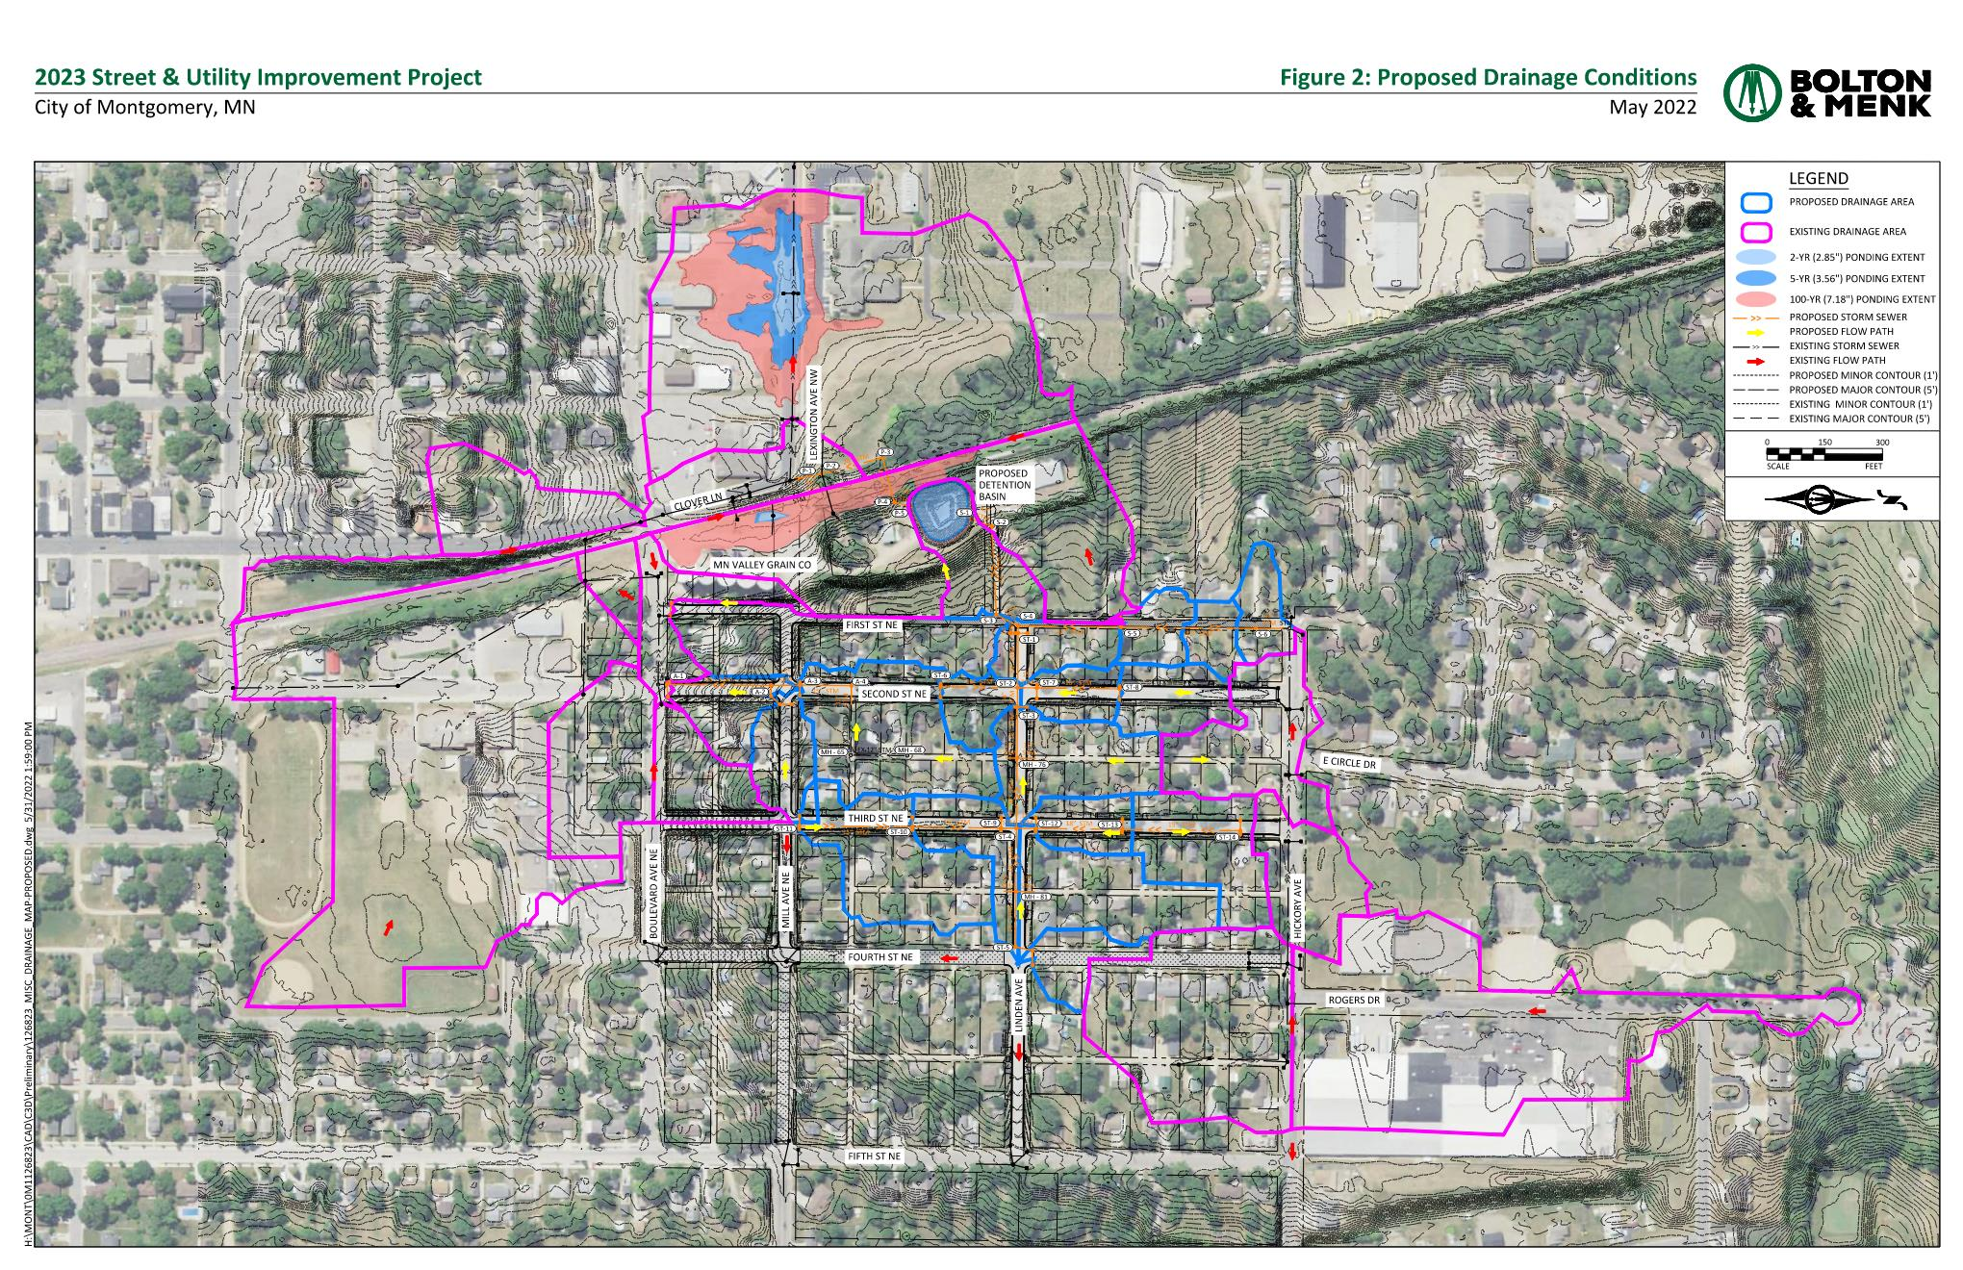

Slide 8
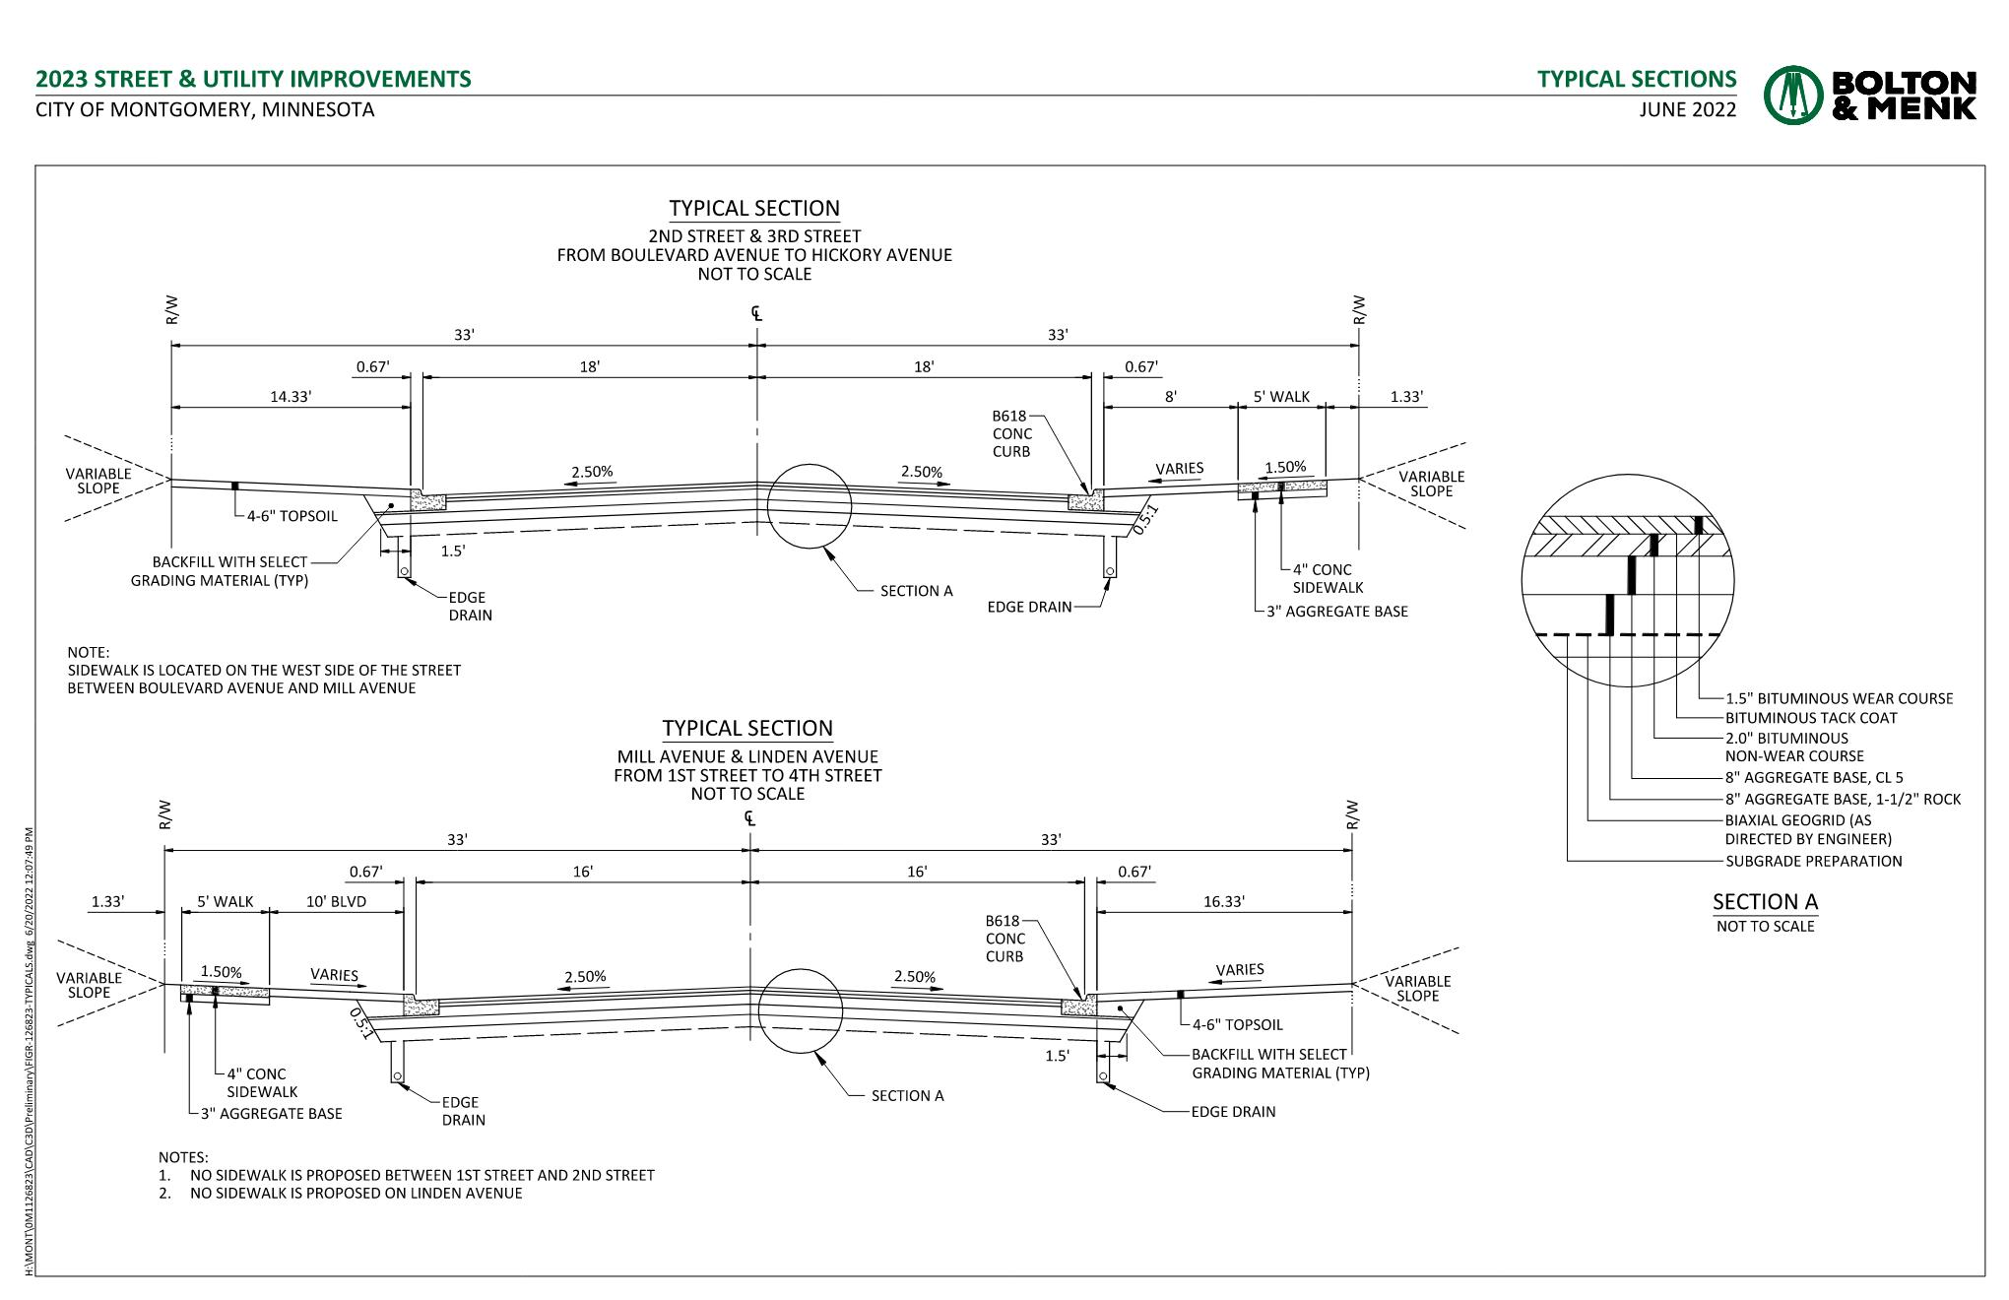
INSERT TYPICAL SECTIONS FIGURES WHEN FINALIZED, ADD SLIDES AS NECESSARY

Slide 9
INSERT IMPROVEMENTS FIGURES WHEN FINALIZED, ADD SLIDES AS NECESSARY

Slide 10
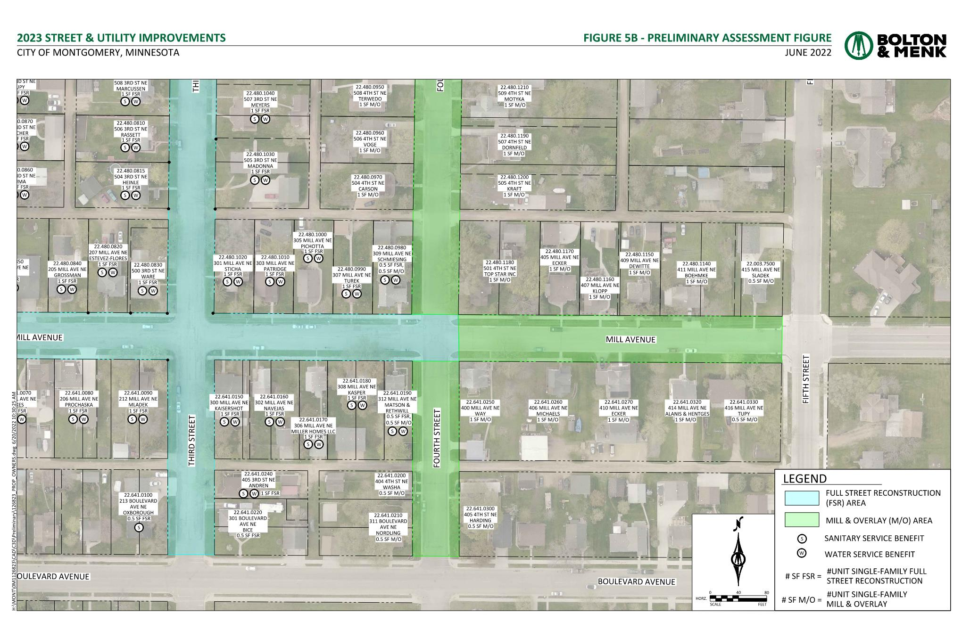
INSERT ASSESSMENT FIGURES WHEN FINALIZED, ADD SLIDES AS NECESSARY

Slide 11
Project Schedule
Hold Improvement Hearing……………………..July 18, 2022
Open House……………………………………………..September 2022
Bid Opening……………………………………………..February 16, 2023
Hold Assessment Hearing…………………………March 20, 2023
Begin Construction…………………………………..April/May 2023
Substantial Completion…………………………….November 2023
Final Completion………………………………………June 2024

Slide 12
Project Cost Estimate
Estimated Costs
Improvement Category | Estimated Cost
Surface: | $3,034.969.64
Sanitary Sewer: | $576,627.46
Watermain: | $766,330.34
Storm Sewer: | $1,065,535.31
Mill & Overlay: | $136,432.26
Total Estimated Project Cost: | $5,579,895.00
Reported as Total Project Costs, including contingency, administration, engineering, testing and legal.

Slide 13
Preliminary Assessment Roll
Street
$7,730.58 per unit of residential full street reconstruction
$123.68 per front-foot of industrial full street reconstruction
$1,783.98 per unit of residential mill and overlay
Water and Sewer
$1,427.18 per unit of residential water service
$1,189.32 per unit of residential sanitary sewer service
The remaining project costs shall be paid by enterprise funds, utility fees, general debt servicing, and the public.
These assessment rates include a 10% inflation from the 2021 Project rates.

Slide 14
Question & Comments
2023 Street & Utility Improvements
Improvement Hearing

