Slide 1
TRUTH IN TAXATION HEARING
2023 TAX LEVY
December 5, 2022

Slide 2
Meeting Purpose
Provide an overview of the general fund, tax levy, and answer resident questions.
Presentation will cover:
  Overview of General Fund
  Budget
  Details on Levy
  Questions

Slide 3
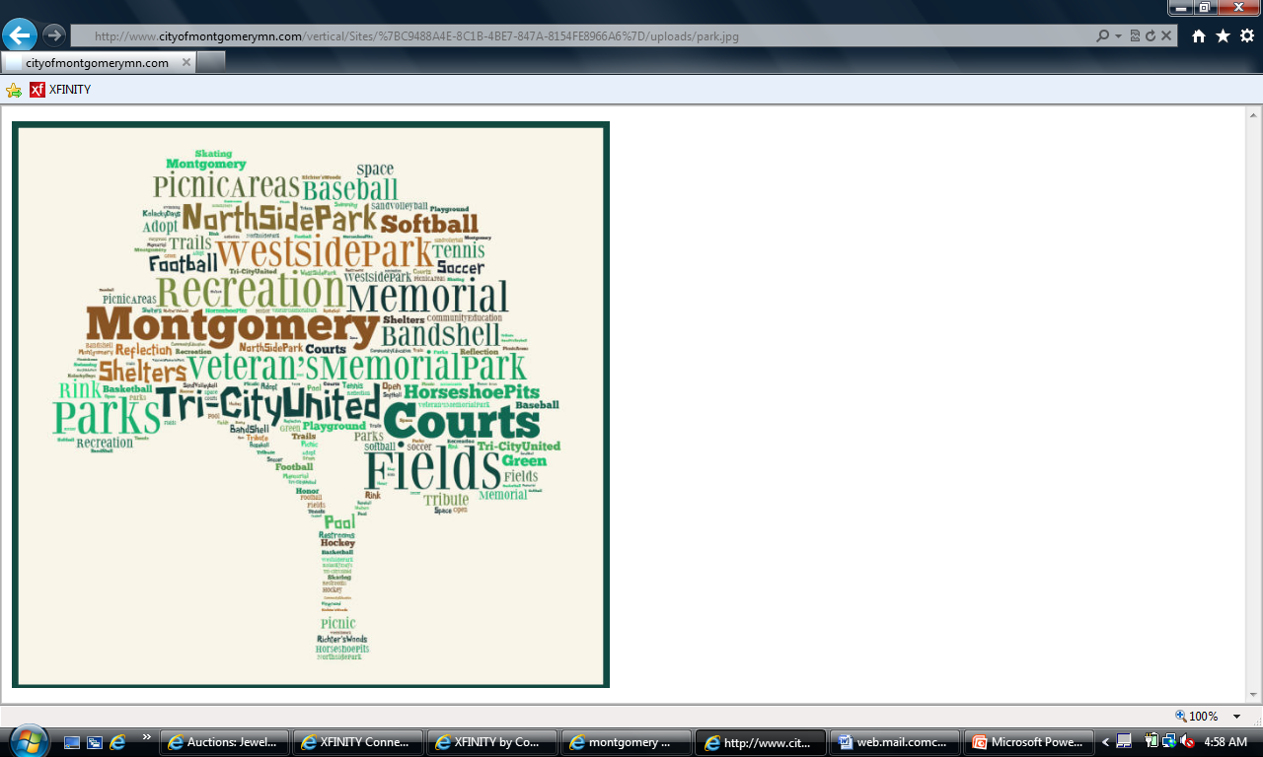
2023 Priorities
Sidewalks & trails
Mosquito Control
Improve Playground & Park Facilities
City Wide Clean-up
Blight / Nuisance Enforcement
Notes:
Street rehabilitation and maintenance remain #1 priority

Slide 4
How priorities are met
Advisory board planning.
Planned transfers to improvement funds.
Applying for grants.
More proactive enforcement of nuisance violations.
Notes:
Council approved a comprehensive street improvement program; Continues to make transfers to improvement funds; and the creation of a new “municipal facility” fund to address aging building infrastructure.

Slide 5
2023 General Fund Budget
Revenue $3,075,110
Notes:
91% of the general fund revenue is from the property tax and intergovernmental aid.

Slide 6
Spending by Function
$3,075,110
Notes:
Public safety, which is fire and police, accounts for the majority of the general fund spending. To balance the budget, there will be planned use of GF reserves.

Slide 7
Expenditures By Department
EXPENDITURES | 2022 | 2023 | Percent
 | Budget | Budget | Change
COUNCIL | $ 18,515 | $ 24,723 | 33.53%
ELECTIONS | $ 26,079 | $ 18,306 | (29.81%)
ADMINISTRATION | $ 309,137 | $ 373,270 | 20.41%
PLANNING AND ZONING | $ 155,452 | $ 173,160 | 11.39%
POLICE | $ 1,075,524 | $ 1,167,167 | 8.52%
FIRE | $ 170,166 | $ 176,818 | 3.91%
STREETS | $ 435,239 | $ 414,606 | (4.74%)
SNOW AND ICE | $ 58,000 | $ 82,000 | 41.38%
PARKS | $ 143,146 | $ 155,367 | 8.53%
LIBRARY | $ 21,975 | $ 22,675 | 3.19%
UNALLOCATED | $ 434,500 | $ 467,019 | 0.53%
TOTAL GENERAL FUND | $2,847,743 | $3,075,110 | 6.82%
Notes:
Council wages and training; convert PT employee to FT; move street maintenance materials to improvement fund; inflation at 7%

Slide 8
Total Levy (general & debt) $2,174,536
Notes:
Debt levy up $246,053 over 2022.

Slide 9
Total levy up 20.7% from 2022

Slide 10
General Obligation Debt Payment
Levy Supported
 | 2022 | 2023 | Change
326 2012 A Refunding* | $ 157,912 | $ 158,472 | $ 560
327 2015 A 5th Street | $ 134,509 | $ 136,189 | $ 1,680
328 2021A Street Improvement | $ 64,111 | $ 213,913 | $ 149,802
329 2022A Lease Revenue Bond | $ | $ 85,052 | $ 85,052
TOTAL | $ 356, 532 | $ 593,626 | $ 237,094
*2012A Refinancing – no levy needed
Notes:
Will need to levy $192,216 for the 2015A and general capital fund. 2021A will have principal included in 2023.

Slide 11
Debt Levy
Bond | 2022 | 2023 | Difference
401 Capital Fund | $138,000 | $57,601 | ($80,399)
327 2015 A 5th Street | $54,261 | $57,201 | $2,490
328 2021A Street Improvement | - | $158,016 | $158,016
329 2022A Lease Revenue Bond | - | $85,052 | $85,052
Total | $192,261 | $357,870 | $165,609

Slide 12
General Fund Undesignated Reserves
Notes:
The drop in reserves from 2014 to 2015 is due to the creation of improvement funds.

Slide 13
IMPROVEMENT FUND BALANCES
FUND | 12/31/22 ESTIMATED BALANCE
Street Improvement Fund | $832,395
Park Improvement Fund | $225,450
Equipment | $41,736
Facilities | $34,207
TOTAL | $1,133,788

Slide 14
Added Value due to New Home Construction
Year Built | Tax Year | new homes | Estimated Market Value | Taxable Market Value
2016 | 2018 | 7 | $1,358,000 | $13,580
2017 | 2019 | 18 | $3,785,000 | $37,850
2018 | 2020 | 19 | $3,686,270 | $36,862
2019 | 2021 | 15 | $2,881,000 | $28,810
2020 | 2022 | 46 | $8,761,000 | $87,610
2021 | 2023 | 34 | $6,719,000 | $67,190
2022 | 2024 | 15 | $3,653,000 | $36,530
Notes:
Does not include commercial/industrial construction and other improvements. Total add to tax base for 2023 about 11 million.

Slide 15
How Property Tax is Figured
County Sets the value of your property
Taxing authority establishes their budget
Budget determines levy requirement – total expenditures – less program revenue = levy
Total taxable value – residential, commercial, etc. determines tax rate
Tax rate applied to individual taxable value
Taxable value = Market value – market value exclusion x class rate [residential class rate =1%]
Share of levy = taxable value x city tax rate

Slide 16
Tax Rate History

Slide 17
2022 Tax to Estimated 2023 City Tax
EMV= Estimated Market Value. HMVE=Homestead Market Value Exclusion
Year | EMV | HMVE | Net Value | Tax Value | Tax Rate | Est. Tax
2022 | $75,200 | $30,100 | $45,100 | $451 | 67.049% | $302.39
2023 | $92,400 | $28,500 | $63,900 | $639 | 63.206% | $403.89
% Change | 22.9% | (5.6%) | 41.7% | 41.7% | (3.843%) | 33.57%
2022 | $84,700 | $29,600 | $55,100 | $551 | 67.049% | $369.44
2023 | $99,800 | $28,200 | $71,600 | $716 | 63.206% | $452.55
% Change | 17.83% | (4.7%) | 29.95% | 29.95% | (3.843%) | 22.5%
2022 | $115,600 | $27,700 | $87,900 | $879 | 67.049% | $589.36
2023 | $144,000 | $27,100 | $119,720 | $1,197 | 63.206% | $756.58
% Change | 24.6% | (12.35%) | 36.2% | 36.2% | (3.843%) | 28.37%
2022 | $127,600 | $26,600 | $101,000 | $1,010 | 67.049% | $677.19
2023 | $158,800 | $22,900 | $135,900 | $1,359 | 63.206% | $858.97
% Change | 24.5% | (13.73%) | 34.5% | 34.5% | (3.843%) | 26.84%
Notes:
Average home value increase 23%.

Slide 18
Tax comparison continued
Year | EMV | HMVE | Net Value | Tax Value | Tax Rate | Est. Tax
2022 | $176,800 | $22,400 | $154,400 | $1,544 | 67.049% | $1,035.24
2023 | $221,200 | $17,300 | $203,900 | $2,039 | 63.206% | $1,288.77
% Change | 25.11% | (22.6%) | 32.1% | 4.95% | (3.843%) | 24.49%
2022 | $239,800 | $15,700 | $224,100 | $2,241 | 67.049% | $1,502.57
2023 | $297,200 | $10,500 | $286,700 | $2,867 | 63.206% | $1,812.12
% Change | 23.9% | (32.9%) | 27.9% | 27.9% | (3.843%) | 20.6%
2022 | $334,900 | $6,900 | $328,000 | $3,280 | 67.049% | $2,199.21
2023 | $424,000 | $0.00 | $424,000 | $4,240 | 63.206% | $2,679.93
% Change | 26.6% | (100%) | 29.3% | 29.3% | (3.843%) | 21.86%
2022 | $432,200 | $0.00 | $432,200 | $4,322 | 67.049% | $2,897.86
2023 | $540,900 | $0.00 | $540,900 | $5,409 | 63.206% | $3,418.81
% Change | 25.2% | 0.00% | 25.2% | 25.2% | (3.843%) | 19.98%
Notes:
Average tax increase 4.5% - average increase $42.20 from about $20 to just over $120.

Slide 19
QUESTIONS

