Slide 1
2022 TRUTH IN TAXATION HEARING
December 6, 2021

Slide 2
Meeting Purpose
Provide an opportunity for residents to ask questions, learn about the city budget, and tax levy.
Presentation will cover:
  Overview of General Fund
  Budget
  Details on Levy
  Questions

Slide 3
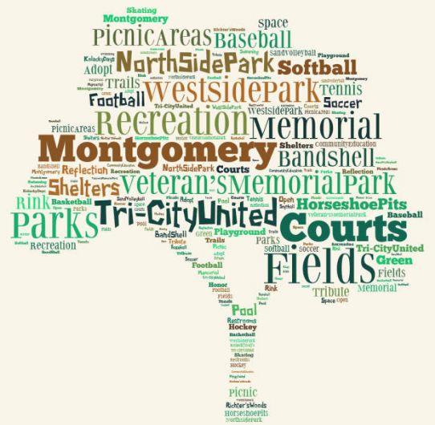
2020 Resident Priorities
Sidewalks & trails
Public Safety
Mosquito Control
City Facilities
Business expansion
& retention
Notes:
Rehabilitation of streets continues to be the #1 concern of residents.

Slide 4
How priorities are met
Parks, Public Works, and Planning & Zoning begin to assess sidewalk / trail connections.
Continue planned transfers to improvement funds – parks, streets, facilities, & equipment.
Applying for grants to help off-set the cost of park improvements.
EDA emphasis on marketing community.
Notes:
Council approved a comprehensive street improvement program; Continues to make transfers to improvement funds; and the creation of a new “municipal facility” fund to address aging building infrastructure.

Slide 5
2022 General Fund Budget
Revenue $2,847,743
Notes:
91% of the general fund revenue is from the property tax and intergovernmental aid.

Slide 6
Spending by Function
$2,847,743
Notes:
Public safety, which is fire and police, accounts for the majority of the general fund spending. To balance the budget, there will be planned use of GF reserves.

Slide 7
For every $1.00 in tax, this is where it goes
Notes:
50 cents of every tax dollar goes to support the police department. This is followed by Streets at 22 cents and administration at 16 cents.

Slide 8
Expenditures By Department
EXPENDITURES | 2021 | 2022 | Percent
 | Budget | Budget | Change
COUNCIL | $ 19,395 | $ 18,515 | (4.5%)
ELECTIONS | $ 1,200 | $ 26,079 | 2073%
ADMINISTRATION | $ 340,046 | $ 309,137 | (9.1%)
PLANNING AND ZONING | $ 126,554 | $ 155,452 | 7.6%
POLICE | $ 1,014,774 | $ 1,075,524 | 5.9%
FIRE | $ 158,900 | $ 170,166 | 7.1%
STREETS | $ 411,125 | $ 435,239 | 5.9%
SNOW AND ICE | $ 31,500 | $ 58,000 | 84.1%
PARKS | $ 114,023 | $ 143,146 | 25.5%
LIBRARY | $ 22,375 | $ 21,975 | (1.8%)
UNALLOCATED | $ 467,734 | $ 434,500 | (3.4%)
TOTAL GENERAL FUND | $2,727,647 | $2,847,743 | 5.2%
Notes:
Election in 2022 – one possible primary and general

Slide 9
Total Levy (general & debt) $1,802,205
Notes:
The 2019 total levy was $1,632,667. 2020 levy going down $26,401.

Slide 10
Total levy up 7.1% from 2021
Notes:
Net increase to average taxpayer is roughly 3.5-4.5%

Slide 11
General Obligation Debt Payment
Levy Supported
 | 2021 | 2022 | Change
325 2011 B General Cap. Improvement | $ 30,900 | $ | $ (30,900)
326 2012 A Refunding* | $ 384,313 | $ 157,912 | $ (226,401)
327 2015 A 5th Street | $ 138,535 | $ 134,509 | $ (4,026)
328 2021A Street Improvement** | $ | $ 64,111 | $ 64,111
TOTAL | $ 553, 748 | $ 356,532 | $ (197,216)
*2012A Refinancing – no levy needed
**2021A Interest only payment no levy needed
Notes:
Will need to levy $192,216 for the 2015A and general capital fund. 2021A will have principal included in 2023.

Slide 12
General Fund Undesignated Reserves
Notes:
The drop in reserves from 2014 to 2015 is due to the creation of improvement funds.

Slide 13
IMPROVEMENT FUND BALANCES
FUND | 12/31/2021 ESTIMATED BALANCE
Street Improvement Fund | $651,455
Park Improvement Fund | $215,102
Equipment | $73,151
Facilities | $15,087
TOTAL | $954,795
Notes:
Note there is a deficit of over $600,000 in the general capital fund.

Slide 14
Added Value due to New Home Construction
Year Built | Tax Year | new homes | Estimated Market Value | Taxable Market Value
2016 | 2018 | 7 | $1,358,000 | $13,580
2017 | 2019 | 18 | $3,785,000 | $37,850
2018 | 2020 | 19 | $3,686,270 | $36,862
2019 | 2021 | 15 | $2,881,000 | $28,810
2020 | 2022 | 46 | $8,761,000 | $87,610
2021 | 2023 | 34 | $6,719,000 | $67,190
TOTAL |  | 139 | $27,190,270 | $271,903
Notes:
Does not include commercial/industrial construction which = about $3.4 million

Slide 15
Property Tax
Funds County, City, State, School, Other
Every property has a classification defined by statute
Each Classification has a tax rate set by statute [residential = 1% of estimated market value]
County sets the estimated market value
Some properties have a market value exclusion that lowers the taxable amount – decreases as value increases
City, County, School, special districts, etc. establish budget and levy needed to support the budget

Slide 16
Tax Rate History
Notes:
Tax rate estimate for 2022 is 67.049%. Overall tax rate continues to decline, lessening the impact on property taxpayer.

Slide 17
2021 Tax to Estimated 2022 City Tax
EMV= Estimated Market Value. HMVE=Homestead Market Value Exclusion
Year | EMV | HMVE | Net Value | Tax Value | Tax Rate | Est. Tax
2021 | $61,200 | $31,732 | $29,468 | $295 | 68.004% | $200.93
2022 | $65,600 | $31,336 | $34,264 | $343 | 67.049% | $229.74
% Change | 6.7% | (1.3%) | 14% | 14% |  | 14.33%
2021 | $79,400 | $30,000 | $49,400 | $494 | 68.004% | $335.94
2022 | $84,700 | $29,600 | $55,100 | $551 | 67.049% | $369.44
% Change | 6.3% | (1.4%) | 11.5% | 11.5% |  | 9.9%
2021 | $105,600 | $27,700 | $77,900 | $779 | 68.004% | $529.75
2022 | $112,100 | $27,100 | $85,000 | $850 | 67.049% | $569.92
% Change | 5.8% | (2.2%) | 9.1% | 9.1% |  | 7.6%
2021 | $164,700 | $22,400 | $142,300 | $1,423 | 68.004% | $970.30
2022 | $173,300 | $21,600 | $151,700 | $1,517 | 67.049% | $1,017.13
% Change | 4.9% | (3.7%) | 6.6% | 6.6% |  | 4.8%
Notes:
Average home value increase 4.43%. Lower value homes had a larger increase by percent than higher value homes.

Slide 18
Tax comparison continued
Year | EMV | HMVE | Net Value | Tax Value | Tax Rate | Est. Tax
2021 | $204,500 | $18,800 | $185,700 | $1,857 | 68.004% | $1,266.23
2022 | $213,100 | $18,000 | $195,000 | $1,950 | 67.049% | $1,309.18
% Change | 4.8% | (4.4%) | 4.8% | 4.95% |  | 3.5%
2021 | $230,400 | $16,500 | $213,900 | $2,139 | 68.004% | $1,454.61
2022 | $238,500 | $15,775 | $222,725 | $2,227 | 67.049% | $1,493.18
% Change | 3.4% | (4.6%) | 3.9% | 3.9% |  | 2.7%
2021 | $352,700 | $5,500 | $347,200 | $3,472 | 68.004% | $2,361.10
2022 | $375,200 | $3,500 | $371,700 | $3,717 | 67.049% | $2,492.21
% Change | 6% | (57.1%) | 6.6% | 6.6% |  | 5.5%
2021 | $407,500 | $0.00 | $407,500 | $4,075 | 68.004% | $2,771.63
2022 | $432,200 | $0.00 | $432,200 | $4,322 | 67.049% | $2,897.86
% Change | 5.7% | 0.00% | 5.7% | 6.0% |  | 4.6%
Notes:
Average tax increase 4.5% - average increase $42.20 from about $20 to just over $120.

Slide 19
QUESTIONS

